Slide 1
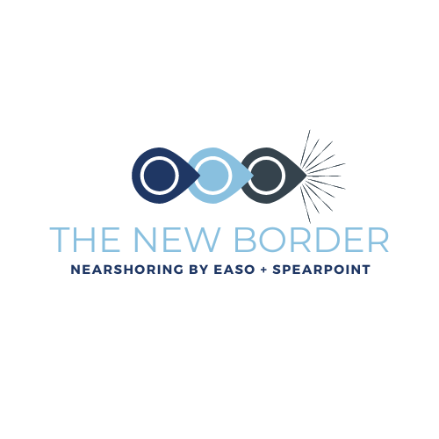
The New Border Service
Mexico Crossborder Heavyweight Intermodal Service
EASO.COM
SPEARPOINTLOGISTICS.COM
Your Mexico Supply Chain Experts

Slide 2
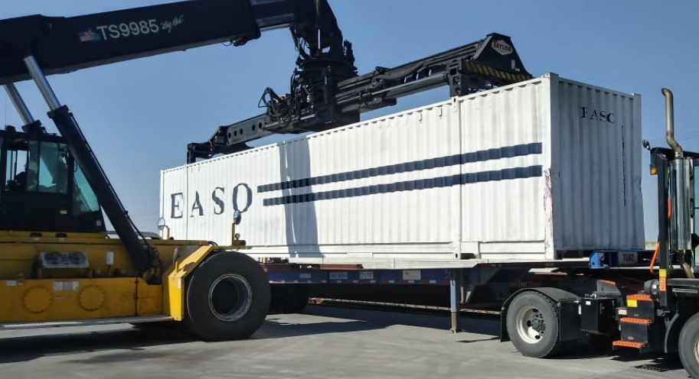
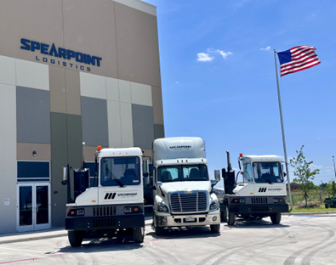
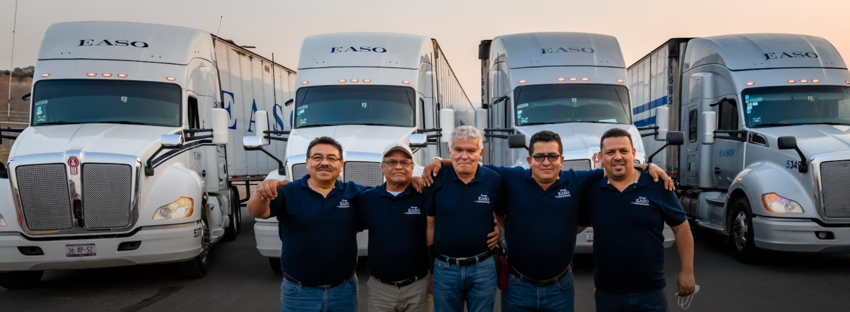
EASO & Spearpoint Partnership – Asset Based Providers
Transportes EASO
Largest Mexico-owned Asset Based Intermodal service provider
Leading Mexican company in the freight transport market with over 50 years experience
Provides Intermodal, Dedicated Service, Spot Service, and 3PL Logistics
Spearpoint Logistics
Provides Warehousing across multiple US Markets
Provides FTL & LTL Transportation Solutions including port & rail terminal drayage
TIA Member
UIIA Member
Overweight Intermodal Experts
We guarantee 53’ Container Capacity for Northbound & Southbound Mexico Transportation

Slide 3
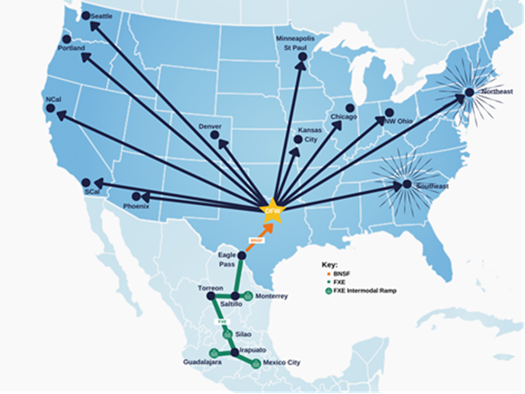
The New Border
NEW HUB & SPOKE SUPPLY CHAIN SERVICE
BENEFITS OF USING DFW
AS A HUB FOR MEXICO DISTRIBUTION TO THE US
GUARANTEED INTERMODAL 53’ CAPACITY TO SHIP FROM MEXICO TO DFW BY TRANSPORTES EASO
HEAVYWEIGHT LOADING FROM MEXICO TO DFW - NO PERMITS REQUIRED – Up to 67,200 lbs. Gross Weight – 25% FEWER IMPORT CONTAINERS
UNMATCHED OUTBOUND DFW TRANSPORTATION CAPACITY, OPTIONALITY AND LOWEST COST PER MILE
DRAMMATICALLY IMPROVED SECURITY & A 60-75% REDUCTION IN CARBON FOOTPRINT VS OTR
OPTIMAL SUPPLY CHAIN RESILIENCY – REACH ALL MAJOR U.S. MARKETS WITHIN 2 DAYS
FLEXIBILITY – INTERMODAL, FTL, LTL & PARCEL WITH JB HUNT, UPS & FEDEX WITHIN 1 MILE
WAREHOUSE IS FOOD GRADE & CTPAT COMPLIANT
CROSSDOCK OR INVENTORY PRODUCT IN ALLIANCE, TX
Northbound
Move the Border to DFW
Customs Preclearance allows nonstop service from Mexico to DFW

Slide 4
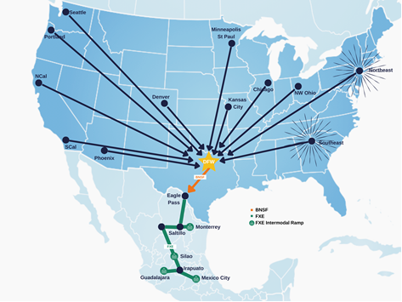

The New Border
NEW HUB & SPOKE SUPPLY CHAIN SERVICE
BENEFITS OF USING DFW
AS A HUB FOR EXPORTS TO MEXICO
GUARANTEED INTERMODAL 53’ CAPACITY TO SHIP FROM DFW TO MEXICO BY TRANSPORTES EASO
HEAVYWEIGHT LOADING FROM DFW TO MEXICO - NO PERMITS REQUIRED – Up to 67,200 lbs. Gross Weight
UNMATCHED OUTBOUND EASO TRANSPORTATION CAPACITY, OPTIONALITY AND LOWEST COST PER MILE
IMPROVED SECURITY & A 60-75% REDUCTION IN CARBON FOOTPRINT
FLEXIBILITY – INTERMODAL, FTL, LTL & PARCEL WITH UPS & FEDEX WITHIN 1 MILE
WAREHOUSE IS FOOD GRADE & CTPAT COMPLIANT
CROSSDOCK OR INVENTORY PRODUCT IN ALLIANCE, TX
Southbound
Consolidate Freight at Alliance and load overweight intermodal to Mexico

Slide 5
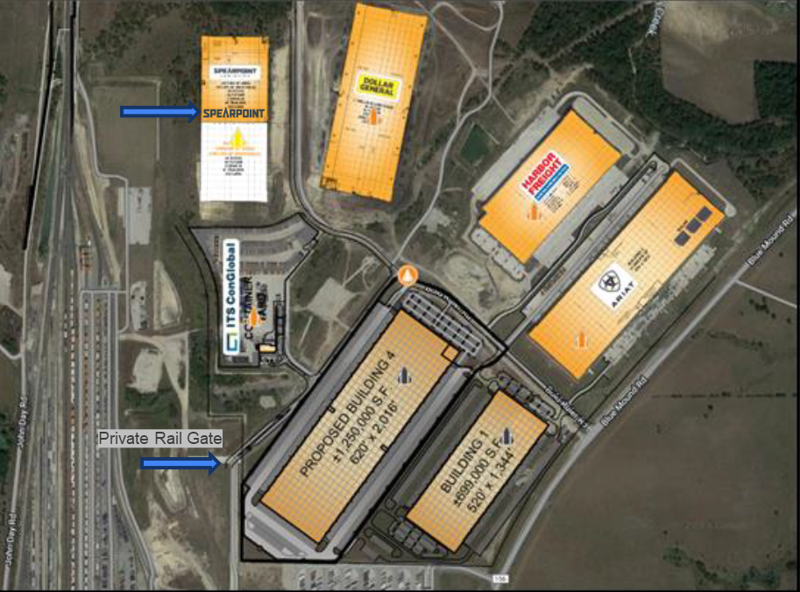

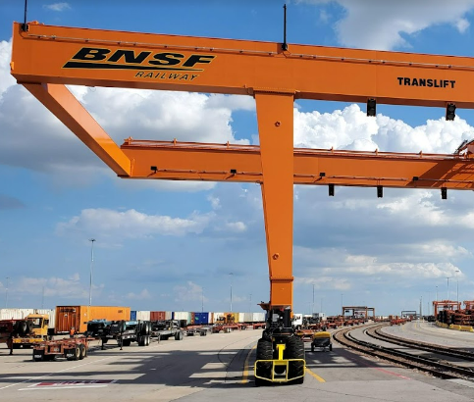
Alliance, TX
(Fort Worth)
Spearpoint Heavyweight Crossdock
Spearpoint Warehouse Location with private road access to rail terminal & allows heavyweight (67,200 lbs. gross weight) per 53’ Container without permits
Private Road

Slide 6
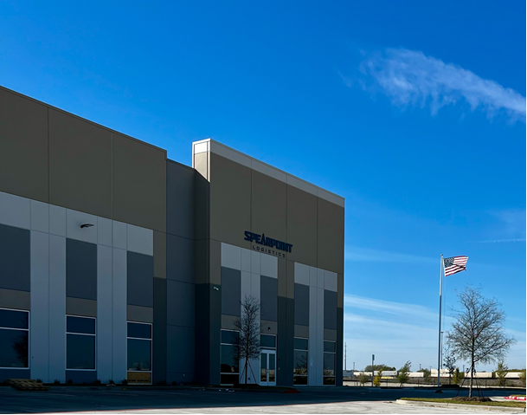
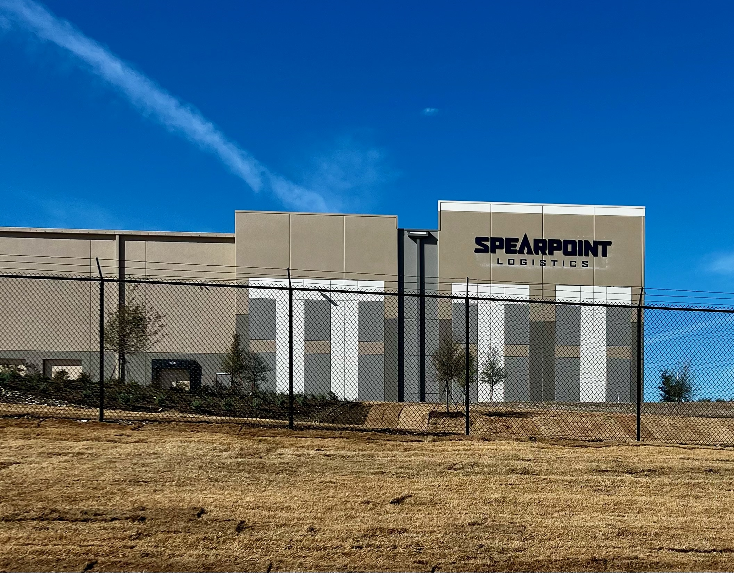
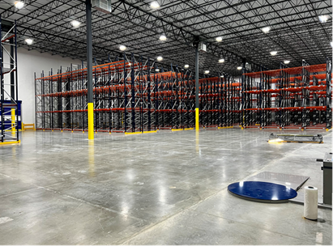





Spearpoint Alliance Warehouse Facility Highlights
627,000 square feet & expandable
153 trailer parking spots
61 dock doors
40’ high ceilings
31,000 square feet of chilled space Available Now
Food grade certified
Heavy weight access without permits
CTPAT compliant
Free Trade Zone
Transloading & Crossdocking
Complete Inventory Services
Private gate & road from BNSF Alliance Rail Terminal
Newly constructed facility
RAMP WMS

Slide 7
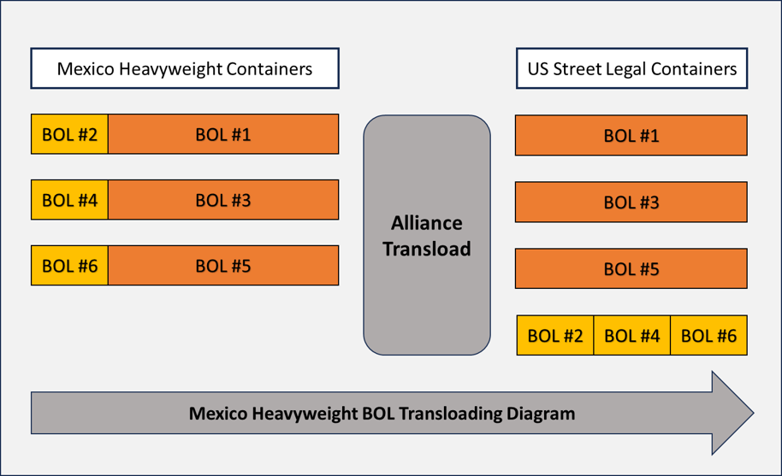
Alliance, TX
(Fort Worth)
Spearpoint Heavyweight Crossdock
Spearpoint Warehouse will sort and segregate inbound pallets based on customer instructions to convert 3 Heavyweight loads to 4 Street legal loads

Slide 8
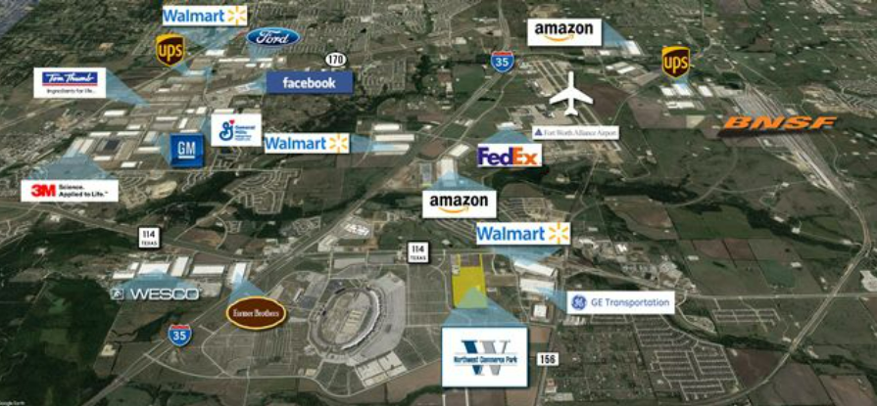

Importance of DFW as a Hub
Why Use DFW as Your US-based Hub?
The Alliance Global Logistics Hub is a true inland port comprised of 9,600 acres.
DFW is imbalanced favorably for outbound Intermodal and OTR capacity and rates
BNSF Railway's Alliance Intermodal Facility performs over 1 million lifts per year; largest US Intermodal Rail Terminal
Area highways enable timely ground transportation throughout the US.
Capacity: Large transportation pool. More than 600 motor carriers operate out of the DFW metro area, and most major U.S. carriers have terminals in Dallas, a fact that offers a shipper a huge range of options when it comes to inbound and outbound transportation.
Safety – Security
Foreign-Trade Zone

Slide 9

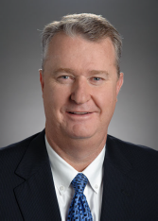
Your Mexico Supply Chain Experts
Diego Anchustegui
Richard Miller
Chief Marketing Officer & Owner of Transportes EASO
Masters degree from the University of Denver in Logistics, Materials & Supply Chain
President of AMTI (Intermodal Association of Mexico)
CEO & Owner of Spearpoint Logistics
Executive MBA from Texas Christian University
Started BNSF Railway de Mexico & led the organization for 13 years
Former President of Lotte Global Logistics
We know Mexico!

Slide 10

THANK YOU
Diego Anchustegui
danchustegui@easo.com
EASO.COM
SPEARPOINTLOGISTICS.COM
Richard Miller
RMiller@SpearpointLogistics.com

Slide 11
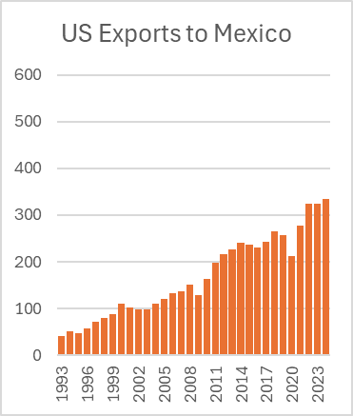
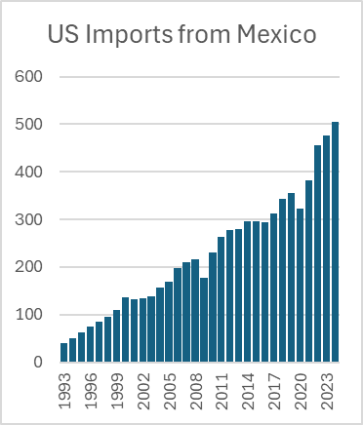
Mexico – US Trade Balance
Northbound flows outpacing southbound
Overall Trade
9% CAGR over 30 years
Based on value of goods – Billions of Dollars
Source: US Census Bureau

Slide 12
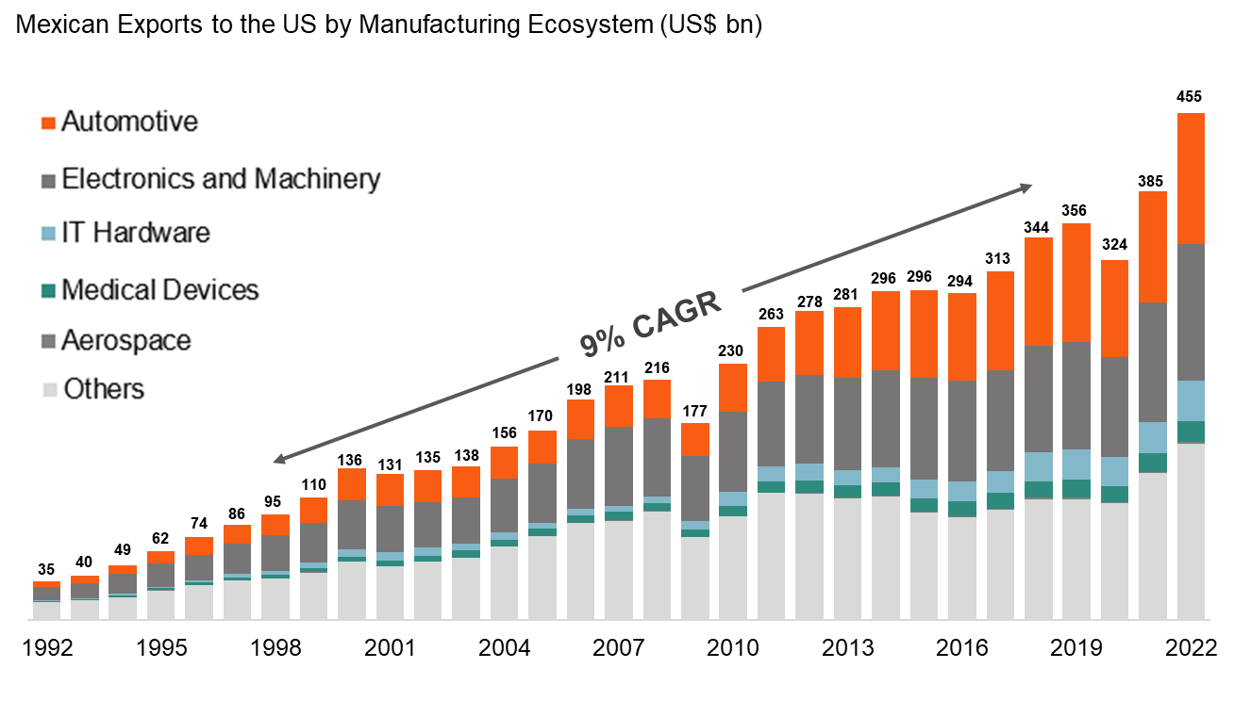
Mexico Exports to the US

